Slide 1
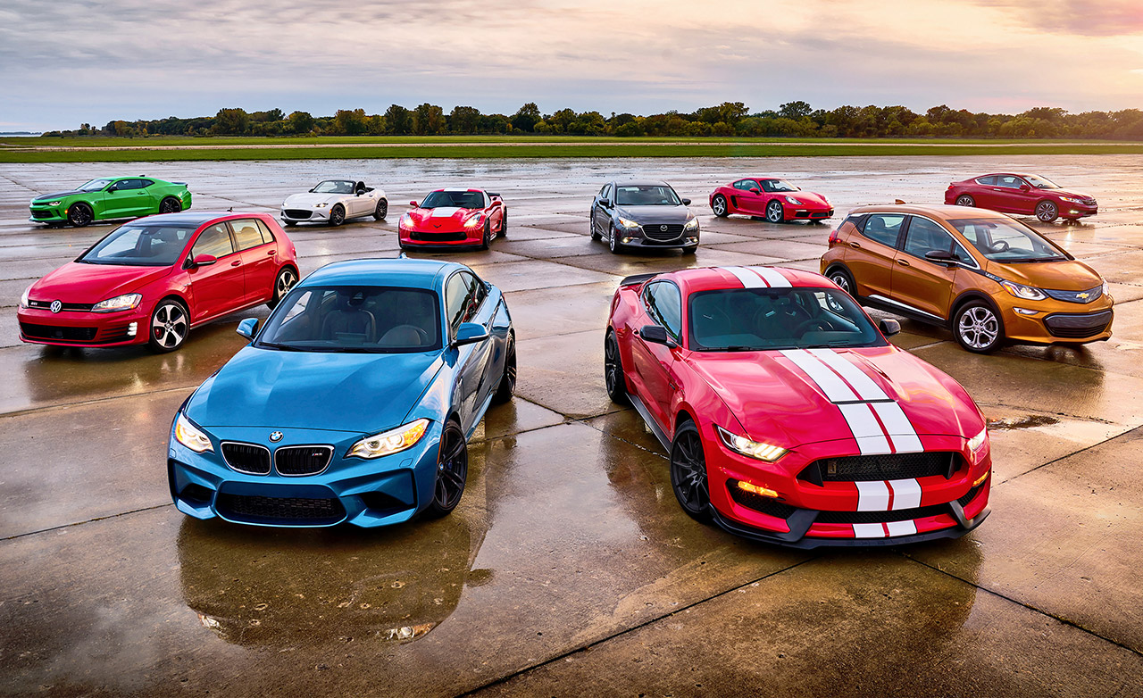
AUTOMOBILE ATTRIBUTES ANALYSIS
By
ILAPAVULURI DEVI PRASAD

Slide 2
CONTENTS
Introduction
Objectives
Dataset description
Data Analysis Overview
Attribute analysis
Summary
Insights

Slide 3
INTRODUCTION
Dataset contains most of the key parameters of cars.
Most of the attributes have a correlation with other variables and this helps in analysing the overall data effectively.

Slide 4
OBJECTIVES
Identify important attributes that impact the efficiency of a car
Do Univariate and Bivariate analysis to understand the relationship and influence
Gain some insights related to Pricing, Safety, Performance on Business Perspective

Slide 5
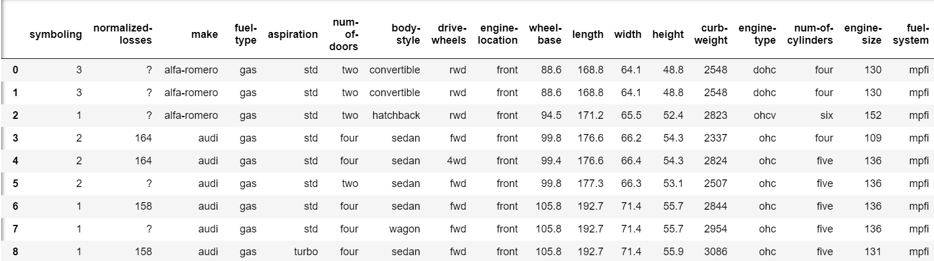
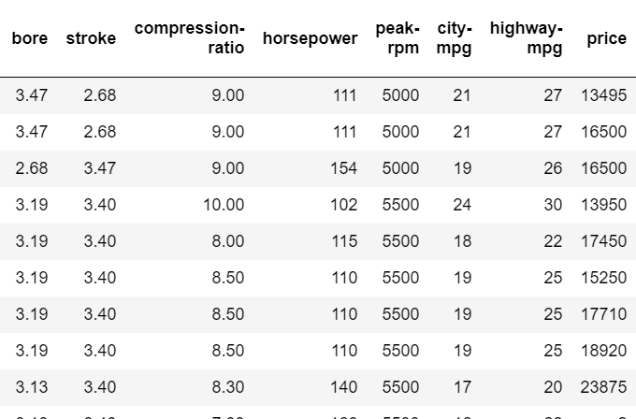
DATASET DESCRIPTION

Slide 6
DATA ANALYSIS OVERVIEW
Data Cleaning
Some columns contained null values like ? They have been replaced with suitable values like Mean and max count().
Attributes like body-style, drive-wheels and engine-type have been replaced with numbers for convenient analysis.

Slide 7
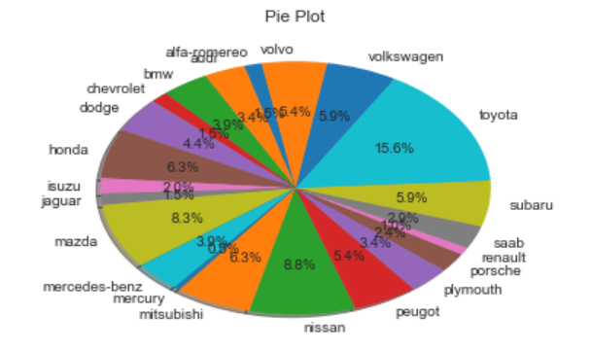
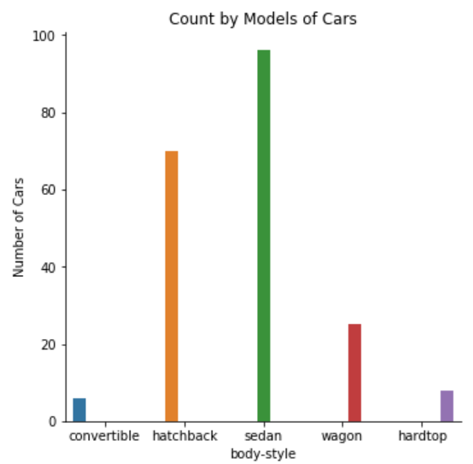
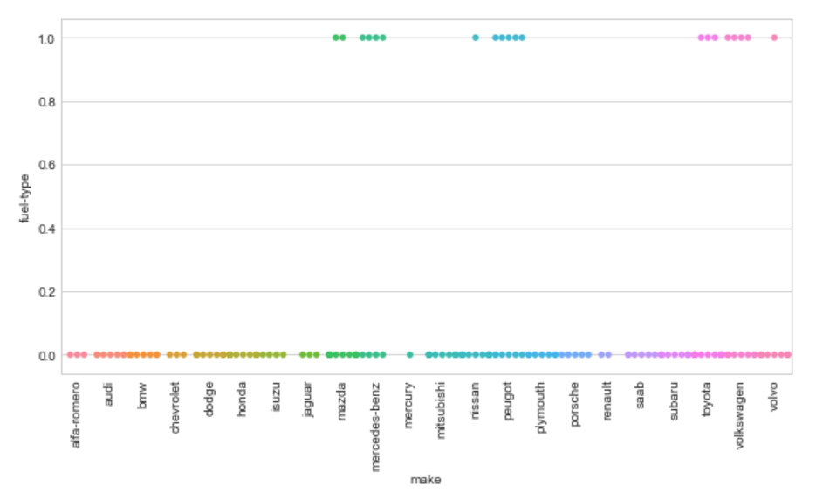
ATTRIBUTE ANALYSIS
Stats of Cars

Slide 8
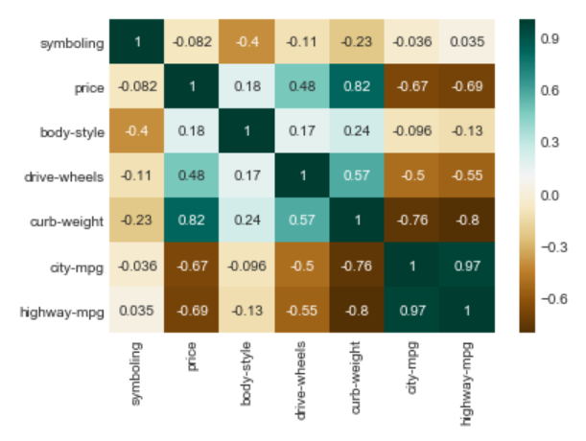
Price
Brand wise Mercedes-Benz followed by BMW manufactures costliest cars.
Body-style wise Sedan segment has both cheap and costly cars. While Hardtop model is the expensive.
Most of the Rear wheel drive cars are costlier compared to front wheel drive.
Cars run on gas are costly compared to the diesel ones.

Slide 9
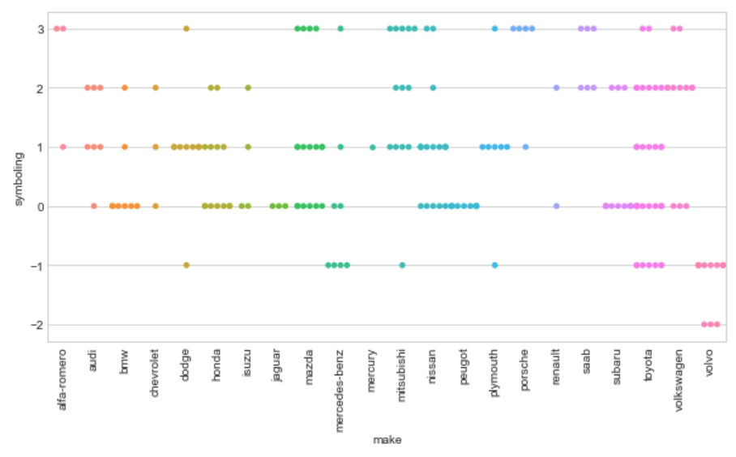
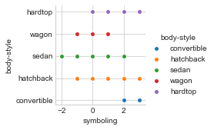
Symboling
It means the degree to which a car is more risky compared to its price.
+3 -> Risky -3 -> Safe
Volvo manufactures safest cars.
Convertible and Hardtop have more risk factor.

Slide 10
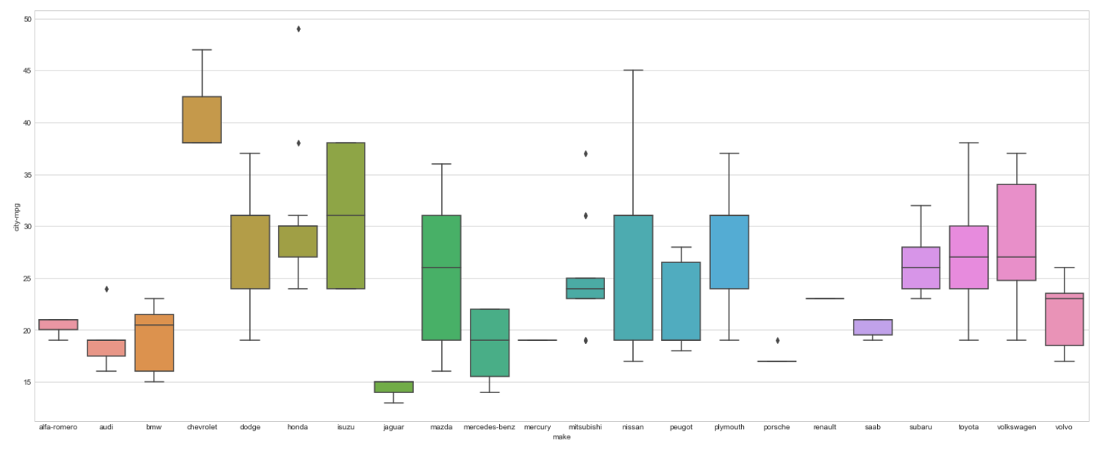
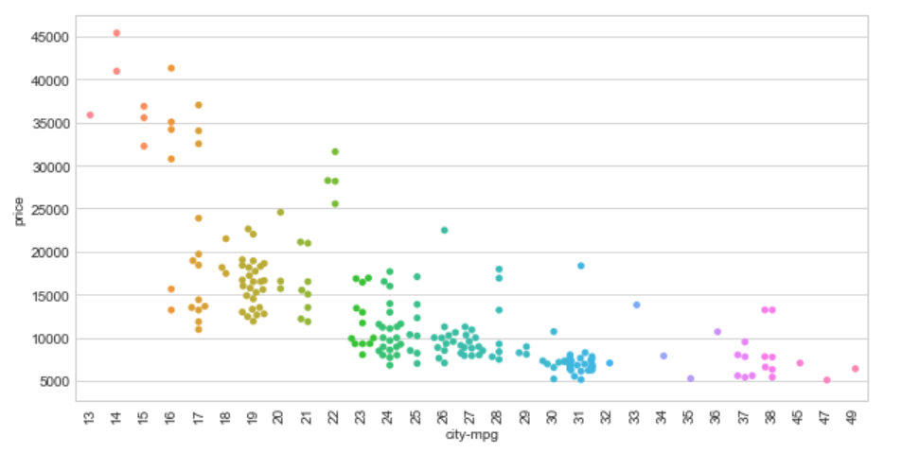
Mileage
Cheverolet cars are the most mileage efficient cars. While Jaguar cars are the least.

Slide 11
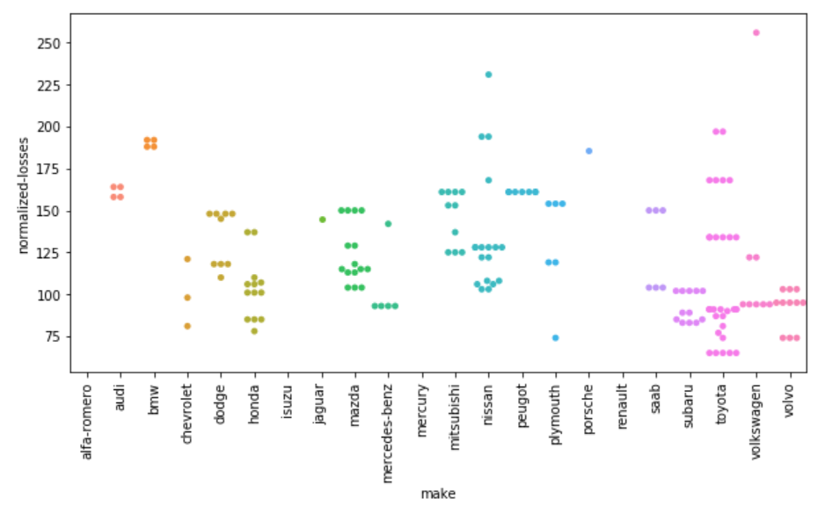
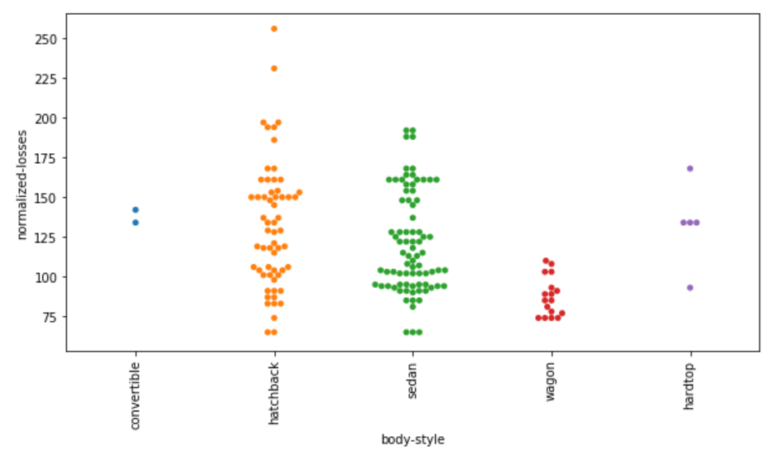
Normalized-losses
Relative average loss payment per insured vehicle year.

Slide 12
Engine-type
ohc, dohc, ohcv, ohcf, rotor and dohcv are the different types engines listed for cars in the dataset.
Maximum number of cars have ohc type of engine.
For analysis, engine-types have been replaced with numbers from 0 to 5.

Slide 13
SUMMARY
Price has been influenced by body-style, horsepower, drive wheels, engine-type and size.
Body-style and engine-type impact the symboling factor mainly alongside with drive-wheels.
Mileage has a close relationship with engine-type and curb-weight.
Normalised losses has link with symboling, body-style and make.

Slide 14
INSIGHTS
Most ohcv engine-types are the costliest. Price can be cut down by switching to ohc.(Mercedes, Nissan)
Rotor engines have great risk.(Mazda)
Sedan type cars are very safe(Volvo) while convertibles(Alfa-romereo) are risky.
Cars with less Curb-weight are good with mileage and economic.

Slide 15
INSIGHTS
Toyota competes with all other cars in all attributes.
Volkswagen has a chance to outbeat Toyota.
Alfa-romereo, Mitsubhishi and Mazda should improve safety.
Less competition in four wheel drives so Subaru and Audi can boost up sales.
Nissan can switch completely to ohc type engines and increase sales.
Jaguar and Porsche are good with horsepower.

